Slide 1
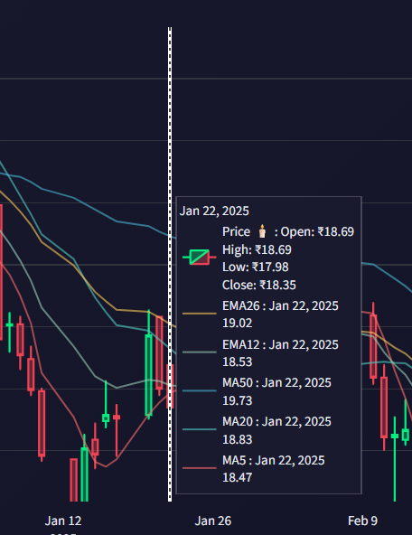
Stock Analytics Dashboard with AI Insights
A comprehensive Streamlit-based platform that combines real-time stock data visualisation with intelligent AI-powered analysis. Explore market trends, interact with live charts, and ask date-specific questions to gain actionable insights into stock performance.

Slide 2








System Architecture Overview
Frontend Layer
Data Source
Streamlit UI with interactive Plotly charts providing responsive, real-time visualisations
yfinance API delivering OHLCV data with comprehensive market coverage
AI Providers
Services Layer
Local Ollama and OpenRouter (Gemma) for flexible, intelligent analysis
Modular clients and helpers ensuring clean separation of concerns
The architecture follows best practices with clear separation between presentation, data retrieval, and AI processing layers, enabling scalability and maintainability.

Slide 3
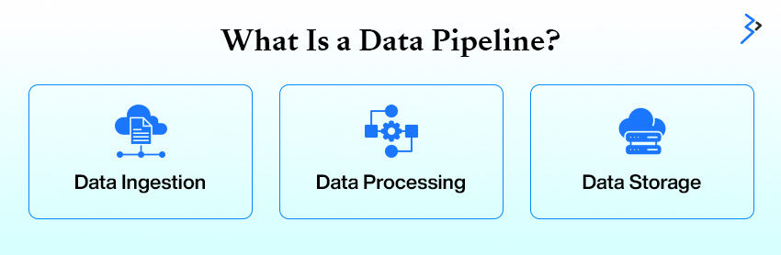
Robust Data Pipeline
Data Acquisition & Processing
Our pipeline leverages yfinance to download comprehensive OHLCV (Open, High, Low, Close, Volume) data with built-in resilience.
Smart caching: TTL-based cache ensures data freshness whilst minimising API calls
Normalisation: Consistent column formatting across different data sources
Error handling: Graceful fallbacks for missing data or API failures
Performance: Optimised queries reduce latency and improve user experience

Slide 4
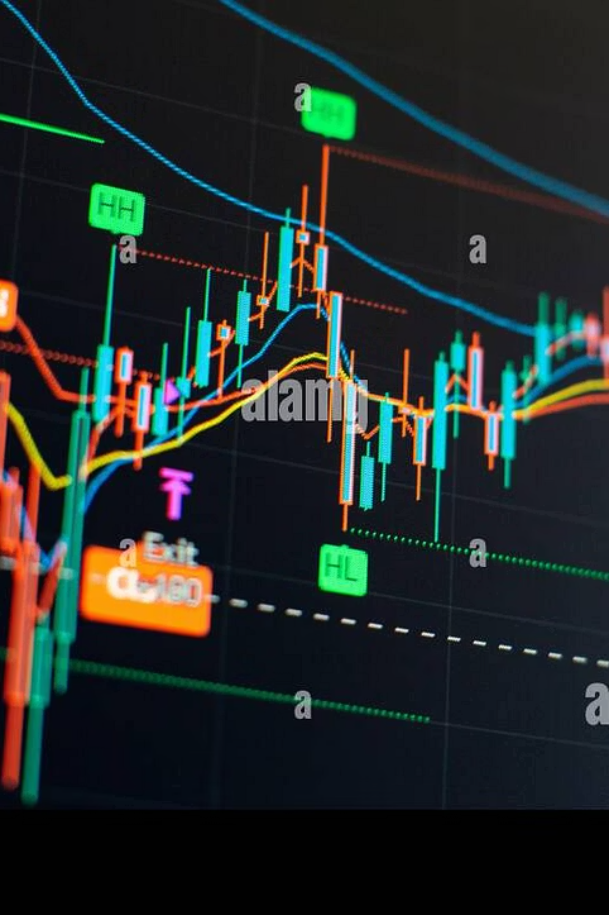
Advanced Visualisation Toolkit
Candlestick Charts
Technical Indicators
Price action visualisation with moving averages (MA) and exponential moving averages (EMA) overlays for trend identification
Dedicated RSI and MACD panels providing momentum and trend strength signals for informed decisions
Interactive Controls
Range slider for period selection, pan/zoom capabilities, and unified hover tooltips for seamless exploration

Slide 5



Intelligent Ticker Management
01
02
Preset Watchlist
Global Search
Curated collection of frequently monitored stocks preserved for quick access and analysis
Yahoo symbol lookup integration enables searching across thousands of global tickers instantly
03
Dynamic Updates
Switching tickers automatically refreshes charts and updates AI context for accurate insights

Slide 6
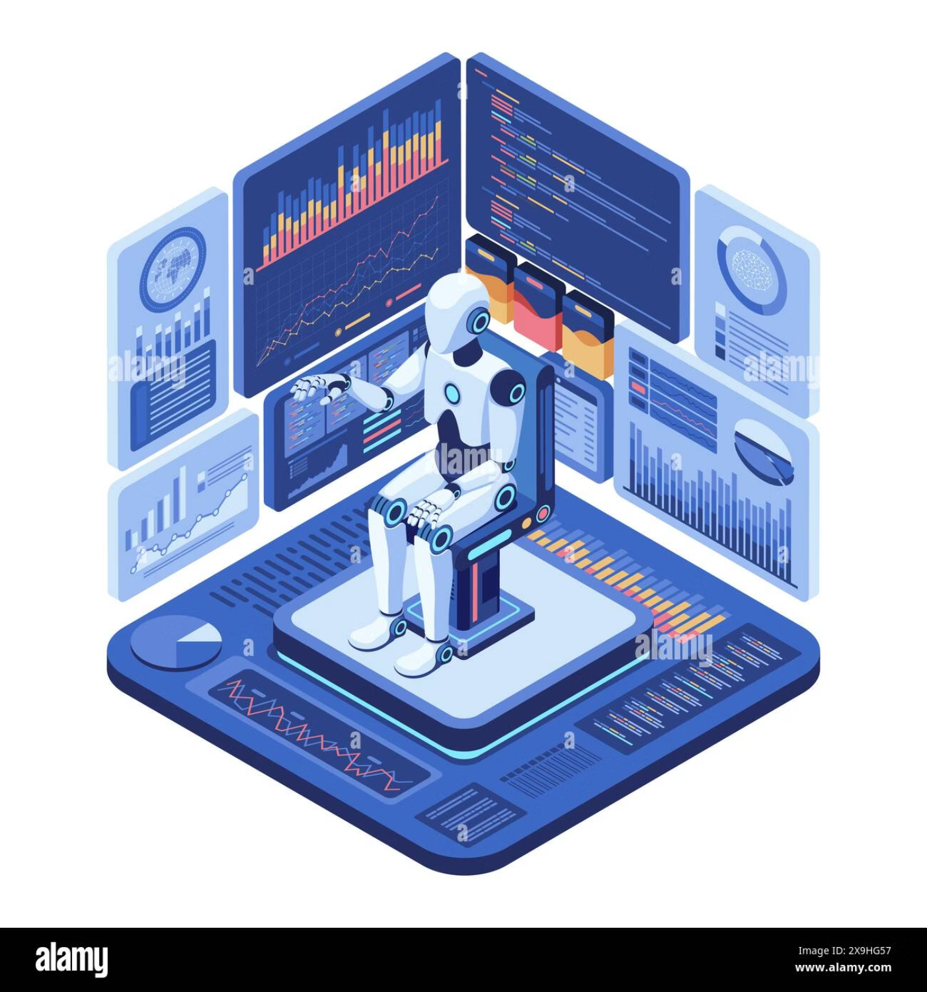
AI-Powered Insights Engine
Dual Provider Architecture
Ollama (Local): Privacy-focused processing without external API dependencies for sensitive analysis
OpenRouter Gemma: Cloud-based model delivering enhanced capabilities and broader context understanding
Intelligent Context Building
Latest statistical summaries and price metrics
Recent closing prices for trend analysis
Date-specific lookups (e.g., "What happened on 29 September 2025?")

Slide 7
Historical Analysis & Comparison
3 Months
12 Months
Short-term trends and momentum shifts
Long-term trajectory and annual performance
1
2
3
6 Months
Mid-range patterns and seasonal effects
Fetch historical data windows for comprehensive temporal analysis. Query specific dates to retrieve exact closing prices and understand market movements. Compare up to two tickers side-by-side to identify correlations, divergences, and relative performance metrics.

Slide 8
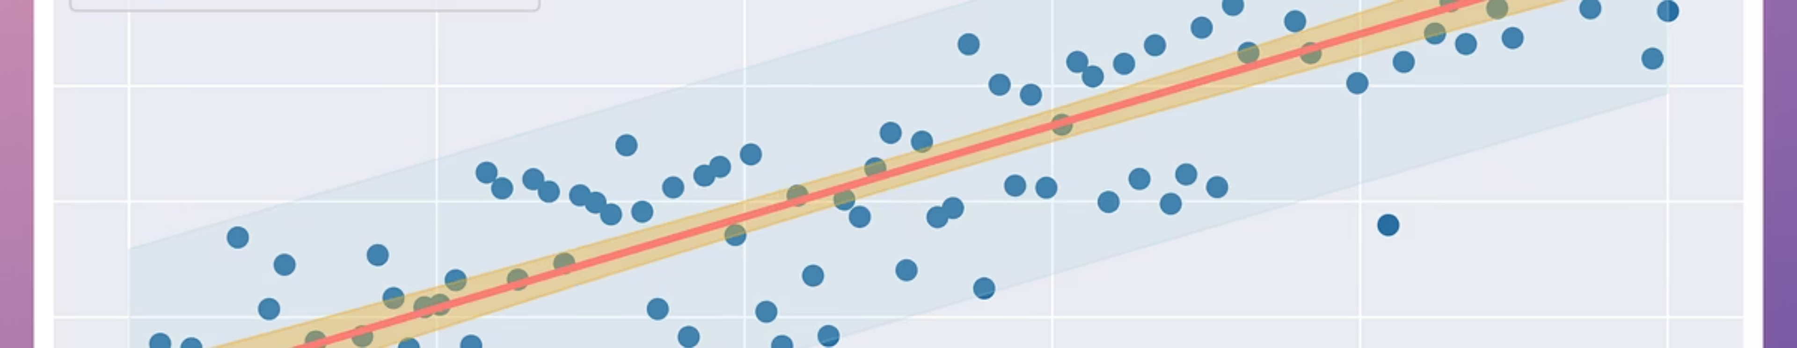



Optional ML Prediction Module
Model Ensemble
Confidence Filtering
Future Projections
Random Forest and other algorithms trained on historical patterns
Predictions below threshold trigger fallback mechanisms
Summary forecasts with transparent uncertainty bounds

Slide 9

Runtime Configuration & Environment
Windows Environment
Launch Command
Secrets Management
Virtual environment (venv) activation ensures isolated dependencies and reproducible builds
.env file stores OPENROUTER_API_KEY securely. Note: OpenAI integration is intentionally excluded from this implementation
python.exe -m streamlit run main.py
Simple execution via Python module invocation

Slide 10
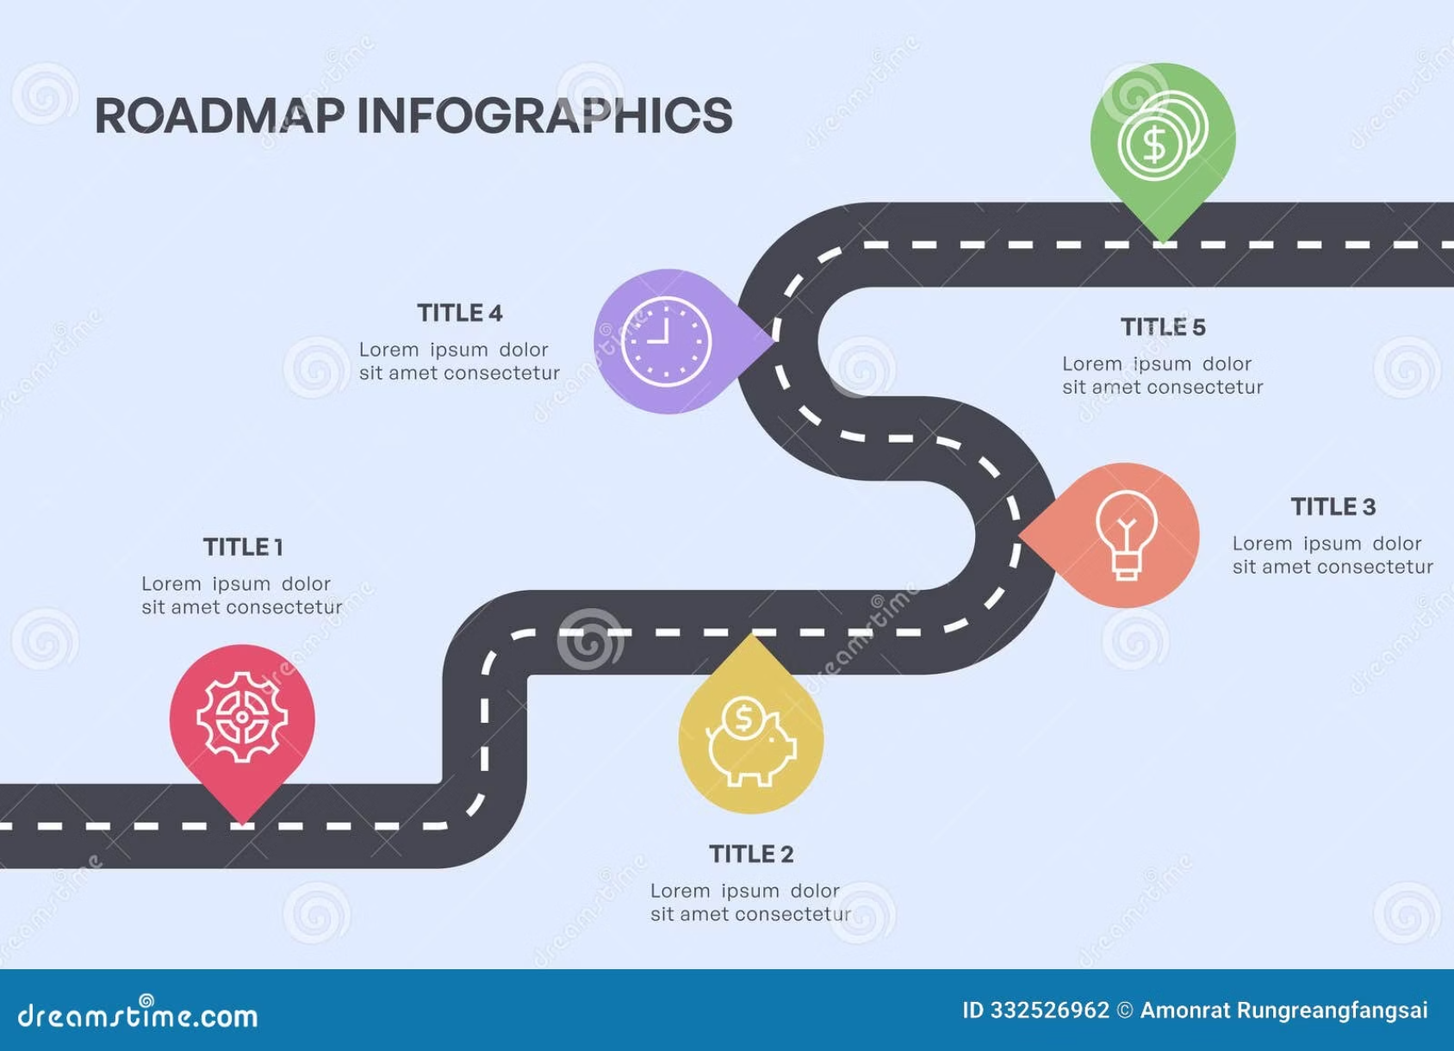
Future Roadmap & Risk Mitigation
Planned Enhancements
Risk Management
Streaming responses: Real-time AI output for improved UX
Rate limits: Implement exponential backoff and request throttling
Favourites system: Personalised watchlists and saved analyses
Data gaps: Validation checks and missing data interpolation
Multi-ticker AI: Comparative insights across portfolio holdings
Model hallucination: Confidence thresholds and source verification
Quality assurance: Comprehensive logging, unit tests, and CI/CD pipelines

Slide 11
THANK YOU

